Slide 1
Cleaning Innovations

Slide 2
AOB
Wessex Overview
Organisational Innovation
Our Performance
Technology Innovation
Chemical Innovation
Machinery & Equipment Innovation
Washroom & Paper Innovation
Wessex In The Community
End

Slide 3
Overview
Established in 1991, we’re an independent supplier of high-quality and sustainably sourced cleaning materials, chemicals, and cleaning machines.​
With a core focus on sustainable service delivery, looking after our environment & local communities and product innovation, our mission is to change what you know about managing janitorial product supply and creating a sustainable future that reinvests into communities and the less privileged.​

Slide 4
Organisational Innovation
Sustainability
Wessex is fully committed to sustainable procurement and operational practices.
We support our customers in achieving their goals by meeting any requirements for new products or sustainability objectives.
Environmental
Continue to grow our environmentally safe product range and act in ways that are kind to the environment by investing in technology, fleet solutions, and operating procedures to drive down our impact on the environment.
Products
We continue to adapt our product range in such ways that only benefit our clients and their customers.
By listening to feedback, our leadership team product test all new innovations to give them the seal of approval before they are used on client sites.
Packaging
Wessex arranges deliveries on a per-site basis with human interaction.
We identify items that are heading to the same location and group products that can be delivered together. We also reuse supplier boxes to prevent further waste.

Slide 5
Our Performance
We have developed a powerful and refined process that allows us to be one of the UK’s leading distributors of cleaning and janitorial equipment. Our numbers say it all.
Customers Served
Products Shipped in 2020
Passionate Employees
11,546
596,896
35

Slide 6
Technology Innovations

Slide 7
iClean Mini
01
The iClean mini™ turns tap water into a safe, effective cleaner and sanitizer that works stronger than bleach and hydrogen peroxide, without the hazardous odours or toxic chemical residues that come with traditional cleaning chemicals.
So safe, will not harm eyes or skin if accidentally splashed
Kill 99.99% of germs – including E.coli, Salmonella, Listeria, COVID – without chemicals*
Quickly, easily remove dirt, grime, stains, odours, mold, mildew, and pesticides
Save time and money by no longer purchasing chemical cleaners, sanitisers, and deodorisers

Slide 8
Aqueous Ozone
02
The Lotus® Pro is a permanent fixture that is mounted onto the wall and connected to your power and water supply, enabling you to create a constant supply of Stabilised Aqueous Ozone from tap water, whenever you need.
Effective at reducing up to 99.999% of harmful bacteria including COVID, E. coli and Salmonella and up to 99.99% on enveloped viruses
As a reusable product, it reduces the amount of single-use plastic packaging likely to end up in our oceans
Safe for staff – non-toxic environment
Eliminates need to purchase multiple chemical products
Between 50-80% in cost savings is normal for most businesses

Slide 9
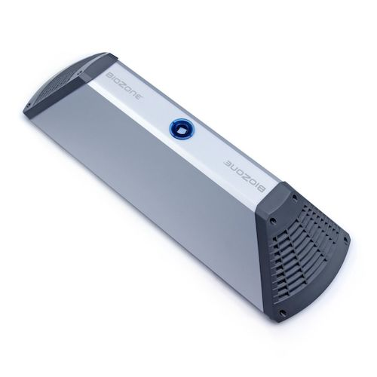
BioZone
03
Creates a fresh-smelling washroom that is pleasant to use by removing odour causing airborne and surface bacteria. Protects washroom users by promoting an hygienic environment that is free of viruses, mold and fungi.
Kills odour-causing microbes at the source, thus eliminating the primary reason for odour
Kills bacteria and viruses in the air and on the exposed surfaces, eliminating the risk of cross contamination
Provides 70% bacteria reduction in the air *Dublin study
Kills 99.9998% of viruses in the air you breathe *CNRS virus tests
Always working: 24 hours a day, 7 days a week
Low energy consumption and maintenance

Slide 10
i-Air
04
The i-air PRO is a a high capacity air healer that improves indoor air quality in medium to large spaces of up to 500m2.
Did you know that indoor air quality can be up to 5-10 times worse than outdoor air quality? Not something to take lightly, considering that we spend an average of 90% of our time indoors.
The i-air PRO filters out solid contaminants, breaking down all VOCs and neutralising all living harmful microbes - including viruses. In short: it delivers the best air you can breathe indoors.

Slide 11
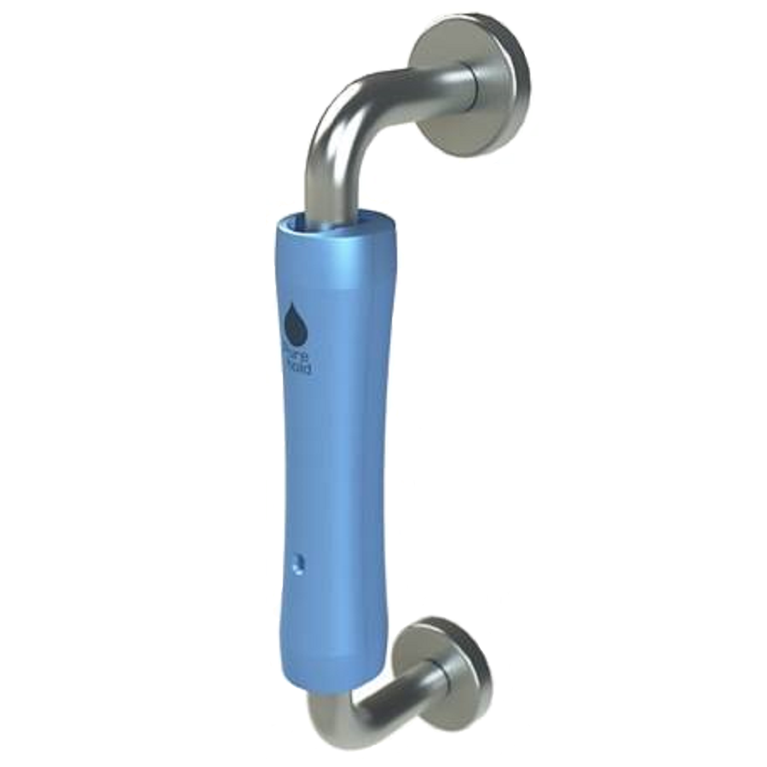
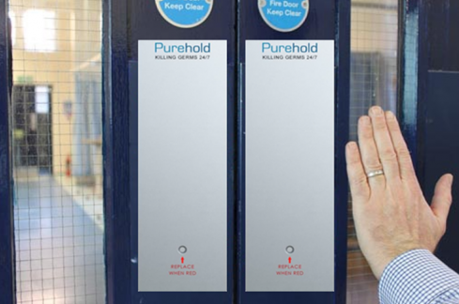
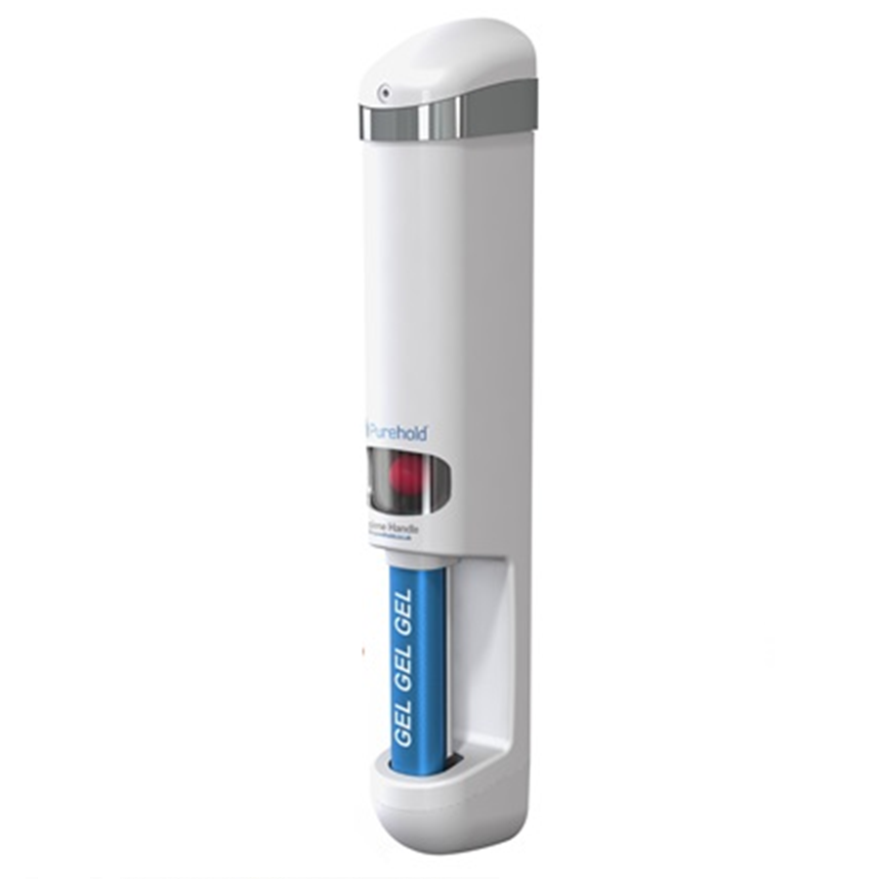
Purehold
05
Pull Handle (also available in other handle types)
Purehold is an innovative set of hygienic door handle/push plate solutions that will improve hand hygiene at your site and reduce cross-contamination between users!
The antibacterial range (PUSH, PULL and LEVER) fits onto existing door handle furniture and are proven to be 96.4% cleaner than standard door furniture.
The Silver Ion coating works continuously 24/7 to combat germs deposited onto the surface by users and helps prevent cross-contamination. The Antibacterial range is perfect for schools, hospitals, banks, office and factories!
Push Plates
Sanitiser Dispensing Handle

Slide 12
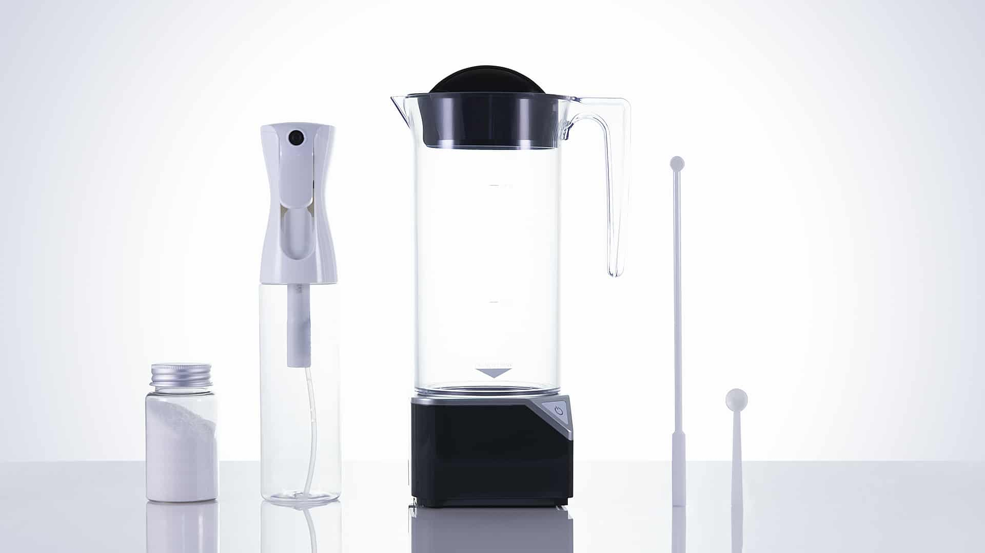
Toucan Eco
06
With just water, salt and a small electrical
Current, the Toucan Eco creates a powerful
multipurpose antibacterial disinfectant cleaner.
One that replaces general disinfectant, all-purpose
cleaners, kitchen and bathroom cleaners, glass and
metal cleaners, and deodorisers.
After seven days, the solution turns back to slightly
salty water. Just make more.

Slide 13
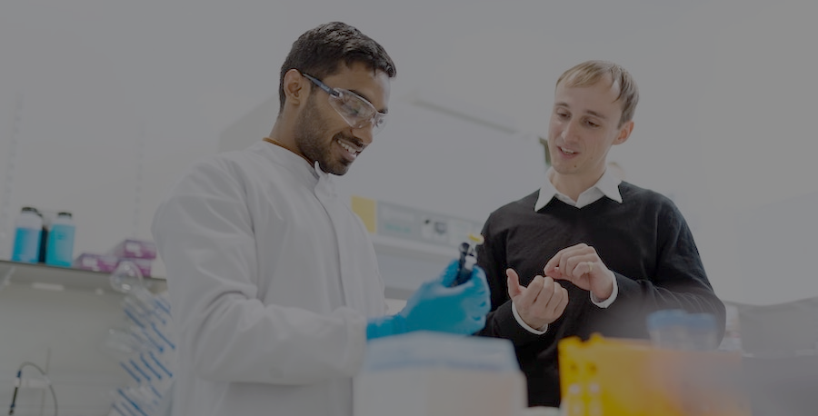
Chemical Innovations

Slide 14
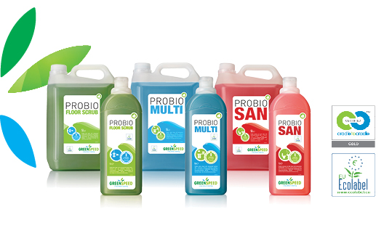
Greenspeed Chemicals
01
Greenspeed offers innovative and effective cleaning solutions, which are user-friendly. Everything they do is focused on quality, innovation and delivering a benefit to the environment.
First company worldwide to obtain the Cradle to Cradle Certification for their chemicals
Nordic Swan Eco & EU ECOLABEL certified
A circular economy where they produce zero waste

Slide 15
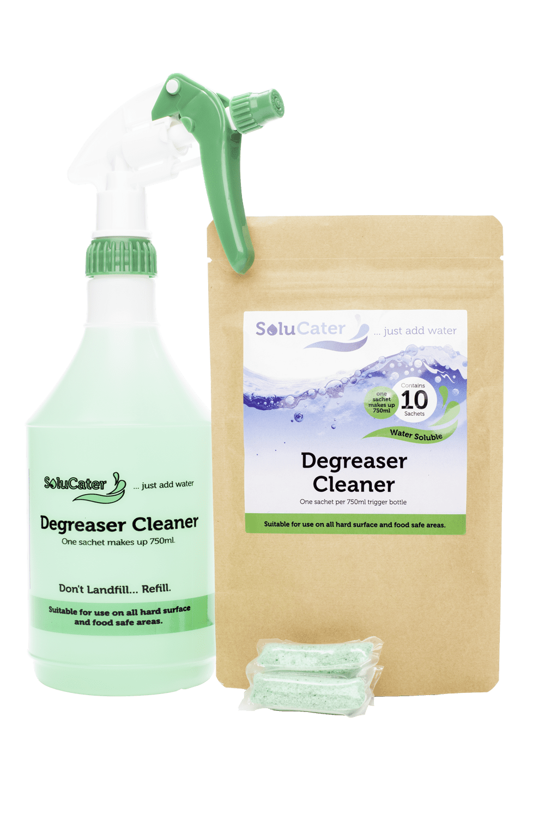
Solupak Chemicals – Just add water
02
Solupak was formed in 1998 and is renowned as the leading expert in
water soluble products. Over nearly 20 years, the company has worked
with many leading brands to develop, formulate, package and distribute
water soluble (PVOH) films and granules.
As specialists in commercial cleaning products , they employ a full in
house technical formulation and development team in the UK.
Manufacturing is all done on site in the UK as well as the concept, R&D,
testing, manufacturing, packaging and distribution.

Slide 16
Machinery & Equipment Innovations

Slide 17
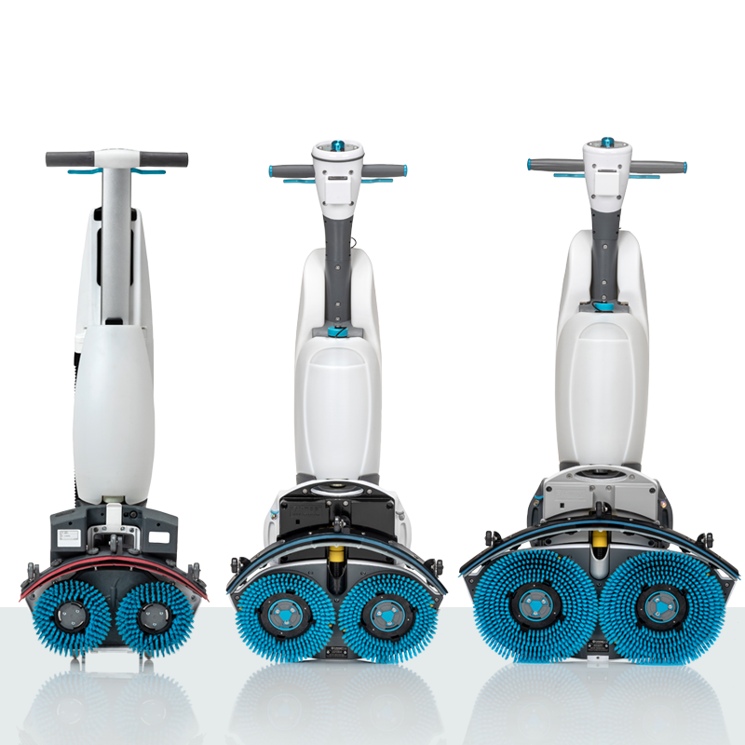
i-mop
01
The i-mop family cleans up to 70% faster than conventional wet mopping and up to 30% faster than conventional auto scrubbing. The i-mop and its ability to get right to the edge and under obstacles means a virtual elimination of manual operations that are required to supplement conventional machine scrubbing.
90% cleaner surfaces compared to conventional mopping
With a fraction of the water and chemicals used by traditional cleaning methods
Reduces environmental impact by over 75%!
Advanced suction technology extracts virtually all of the cleaning solution and whatever liquid happens to be on the floor

Slide 18
Leobot Scrubber Dryer
02
Using cutting edge technology in artificial intelligence, the Leobot focuses on building a pleasant user experience while placing a strong emphasis on total safety, total security and total solutions from the ground up
Water-saving technology uses up to 70% less water than other cleaning robots yet achieves the same high cleaning results
First robots in the world to clean exclusively with Z water - a professional cleaning chemical that is totally safe and environmentally friendly
AI driven learning for better performance
Track progress on the mobile app or operate the robot from anywhere in the world

Slide 19
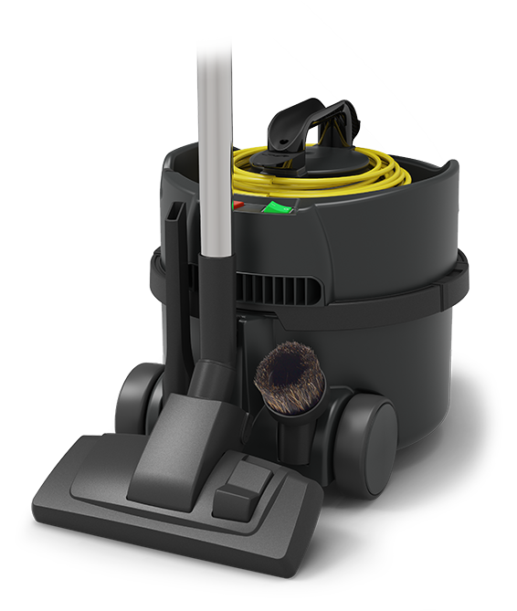
Numatic ReFlo Vacuums
03
Engineered from the highest quality, recycled material using innovative, environmentally sustainable ReFlo Technology.
ReFlo Technology uses high-quality recycled, post-industrial material from the automotive industry, which are diverted from landfill or incineration.
Made from up to 75% of the highest quality, recycled material
30% reduction in energy consumption
High-Performance Cleaning Results
tough, heavy-duty construction

Slide 20
Sustainable Washroom/paper Innovations

Slide 21
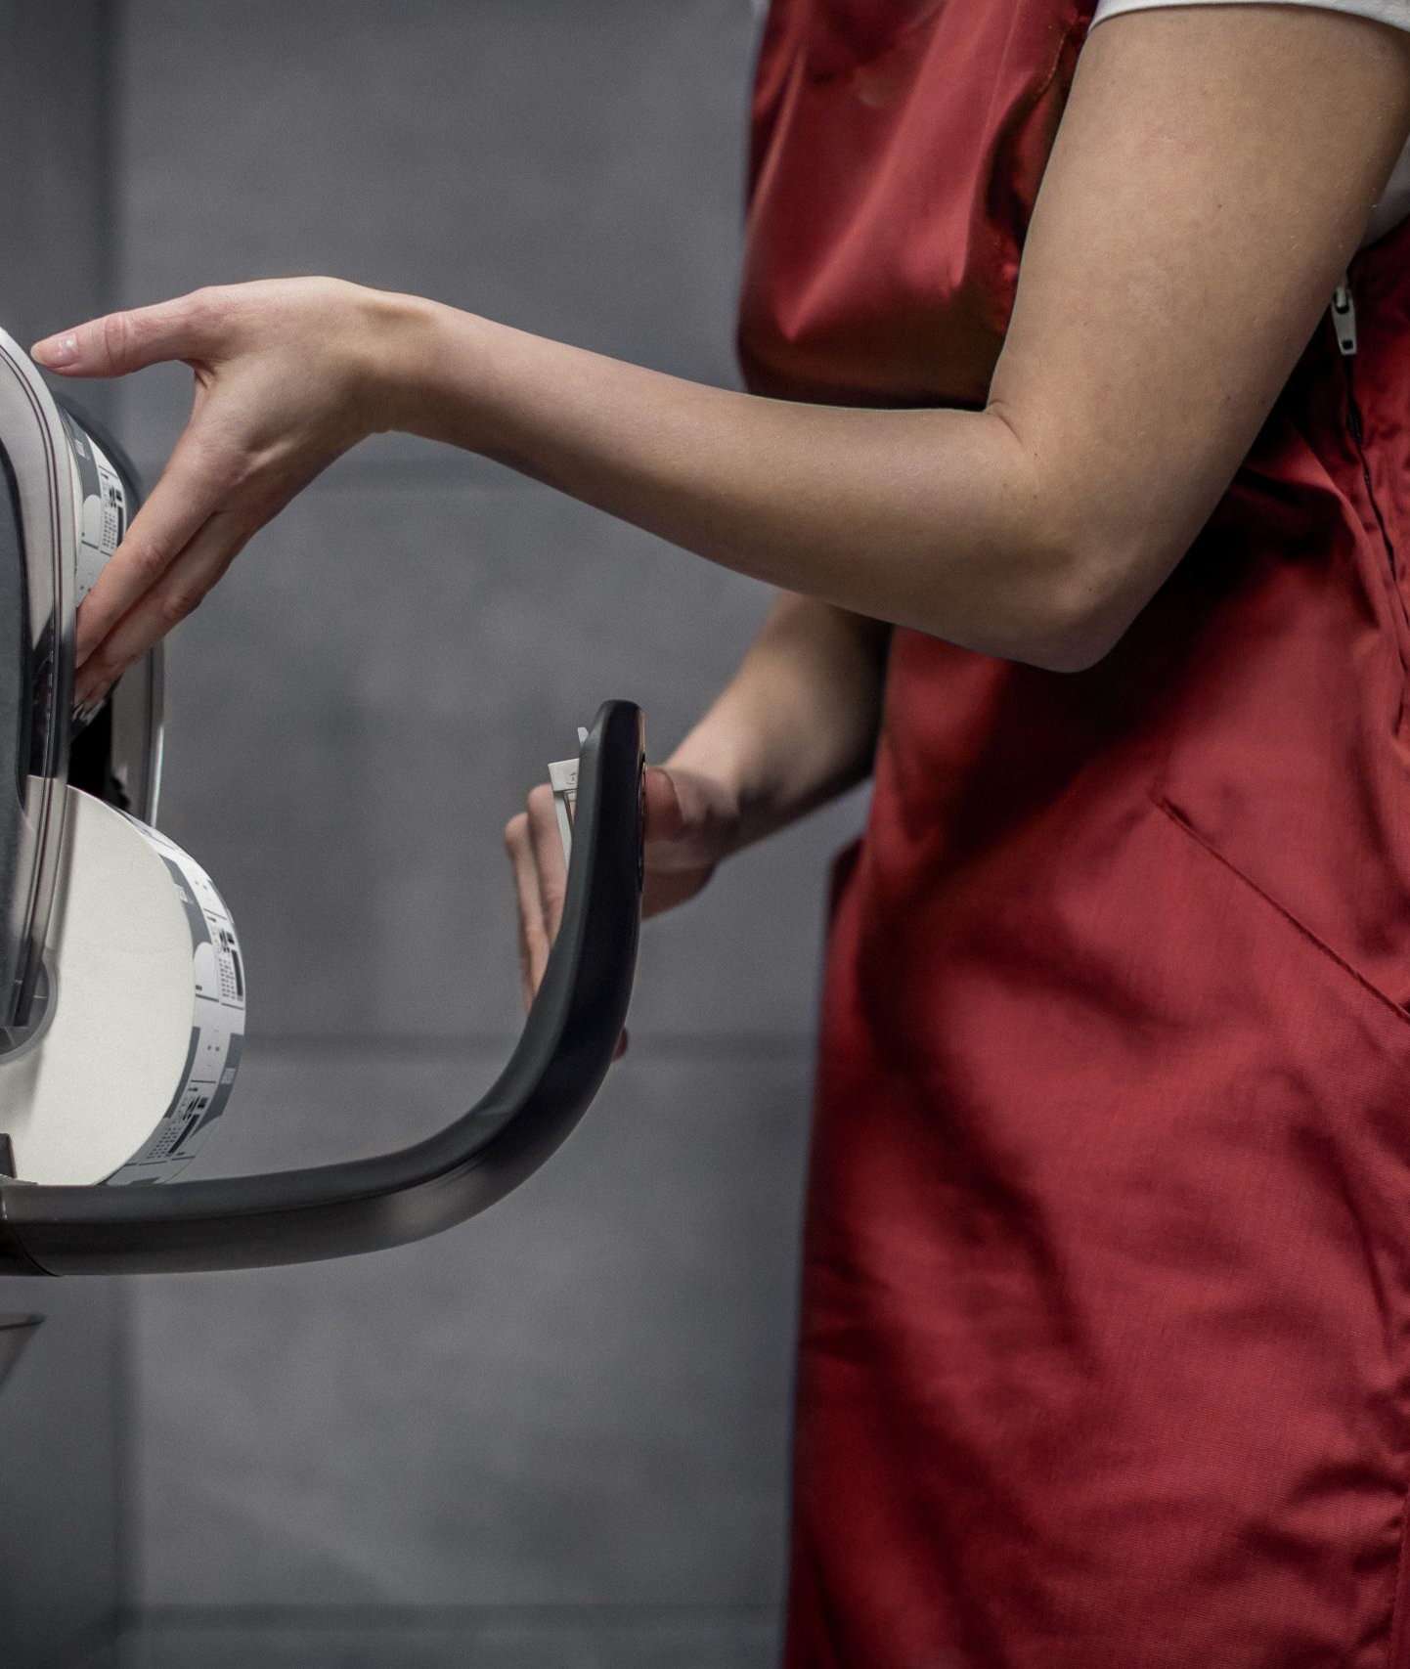
KATRIN Paper Products
01
Katrin’s unique “forest to end-user” value chain guarantees that their products are made sustainable and reliable way. Katrin products are also produced with a focus of lower product consumption and circular economy. In addition Katrin tissue paper products carry the Nordic Swan or the EU eco-label.
Carries the EU Eco Label, Nordic Swan, FSC and PEFC Certifications
Paper towels are mostly recycled
long expertise and substantial customer insights guarantee

Slide 22
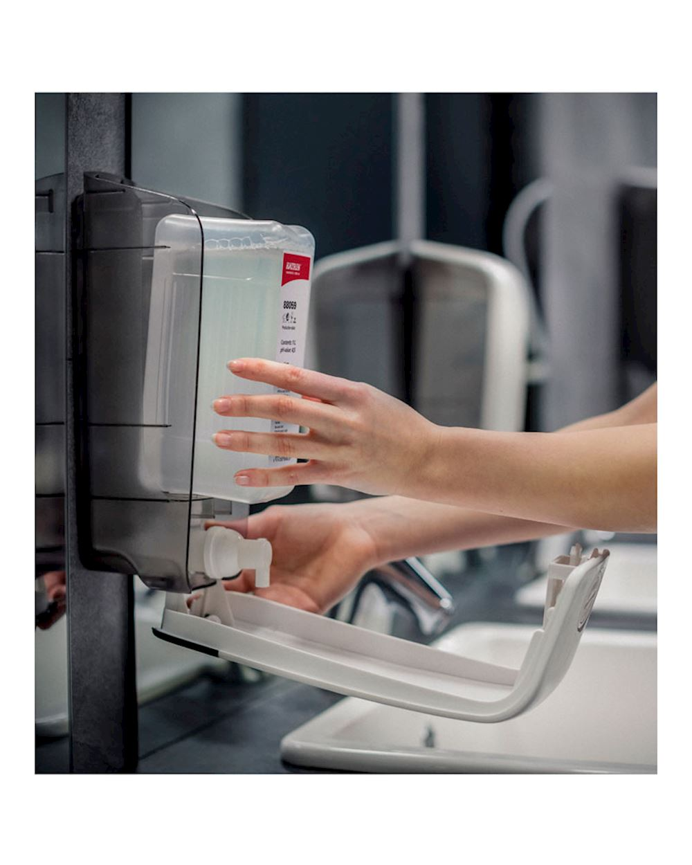
KATRIN Dispensers
02
Katrin strives to minimise the environmental impacts of their operations
and products throughout their life cycle, from sourcing of raw materials to
production and consumption right through to their disposal. They do this
in co-operation with our suppliers, customers, business partners and
Consumers.
Katrin products carry FSC, PEFC, EU ECO, and Nordic Eco certifications.
The plastic parts of our dispensers are completely recyclable.
All black parts are made from recycled plastic
The material of plugs in Katrin System towel rolls will be also changed into recycled material
All Katrin dispensers are made of plastic to ensure they are robust and long-lasting yet recyclable

Slide 23
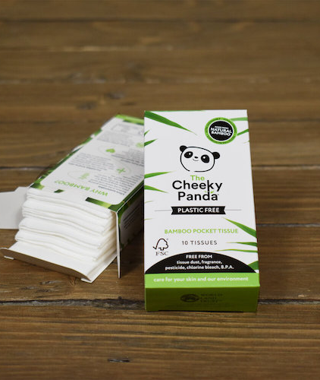
Cheeky Panda Paper Products
03
Cheeky Panda is a B-certified company that's products are made from the fastest growing plant in the world - Bamboo! Renewable, sustainable and generates 65% less carbon emissions than conventional tree-based tissue.
Plastic free company
Reducing deforestation
Bamboo grows 30x faster, absorbs 35% more carbon and produces 30% more oxygen than trees
Carbon emitted by their production and shipment process is offset by donations to the World Land Trust, which helps maintain the rainforest

Slide 24
Wessex In the Community

Slide 25
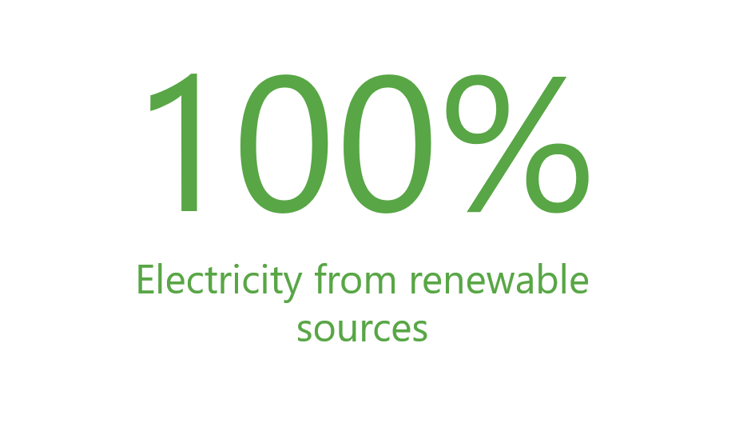
We are teaming up with FareShare to fight hunger in the UK and help over 10,000 charities prevent malnourishment.
We are passionate about sustainability and the environment; this is why we are working towards becoming carbon natural
We supported Cheeky Panda with their educational project to educate students on Eco, sustainability, and environmental practices
We work to power operations and warehouse through a mixture of 100% renewal able energy sources.

Slide 26
Thank you.

